Slide 1
Object Oriented Programming LAB # 04 Constructors in JAVA
ENGR. SANIYA SARIM

Slide 2
Constructors
In Java, a constructor is a block of codes similar to the method. It is called when an instance of the class is created. At the time of calling constructor, memory for the object is allocated in the memory.
It is a special type of method which is used to initialize the object.
Every time an object is created using the new() keyword, at least one constructor is called.

Slide 3
Default Constructor
It calls a default constructor if there is no constructor available in the class. In such case, Java compiler provides a default constructor by default.

Slide 4
Rules for creating Java constructor
Constructor name must be the same as its class name
A Constructor must have no explicit return type
A Java constructor cannot be abstract, static, final, and synchronized

Slide 5
Types of Java constructors
There are two types of constructors in Java:
Default constructor (no-arg constructor)
Parameterized constructor

Slide 6
Java Default Constructor
A constructor is called "Default Constructor" when it doesn't have any parameter.

Slide 7
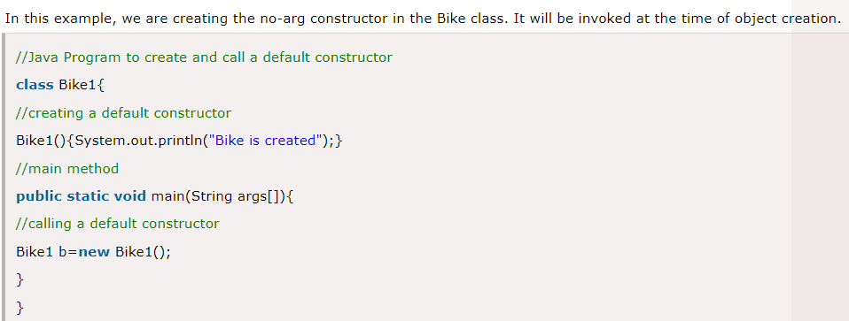
Example of default constructor

Slide 8
Default Values
The default constructor is used to provide the default values to the object like 0, null, etc., depending on the type.

Slide 9
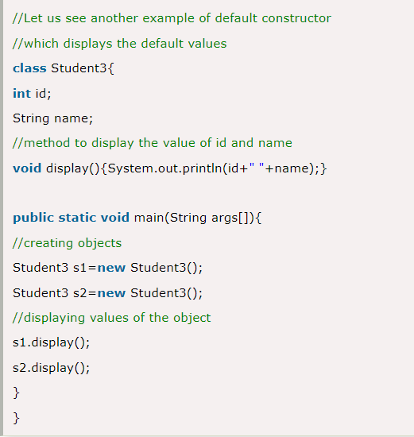
Example

Slide 10
Java Parameterized Constructor
The parameterized constructor is used to provide different values to distinct objects. However, you can provide the same values also.

Slide 11
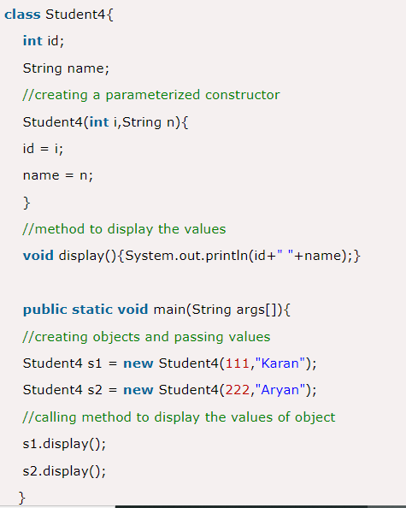
Example of parameterized constructor

Slide 12
Constructor Overloading in Java
Constructor overloading in Java is a technique of having more than one constructor with different parameter lists.
They are arranged in a way that each constructor performs a different task. They are differentiated by the compiler by the number of parameters in the list and their types.

Slide 13
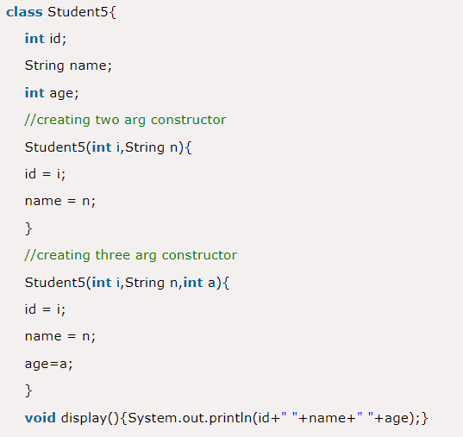
Example

Slide 14
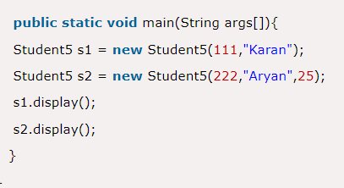
Example Cont…

Slide 15
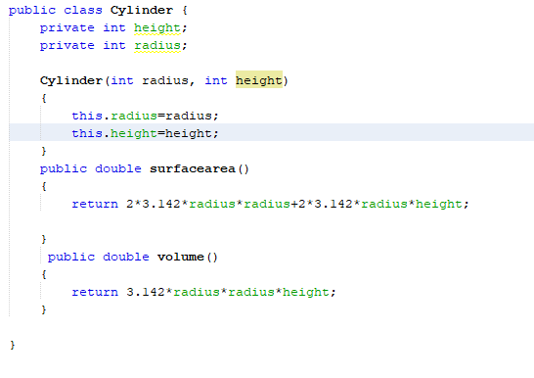
Example of Constructors

Slide 16
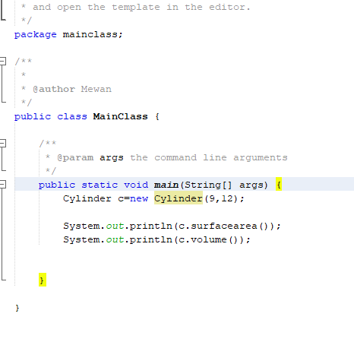
Example Cont..

